Slide 1
INTERVIEW TRAINER agent
IBM AICTE PROJECT
Presented By:
Student name : MOHD ARMAAN Z
College Name & Department : PRESIDENCY UNIVERSITY (B-Tech Computer Science and Engineering)

Slide 2
OUTLINE
Problem Statement
Technology used
Wow factor
End users
Result
Conclusion
Git-hub Link
Future scope
IBM Certifications

Slide 3
Problem Statement
Many job seekers struggle to adequately prepare for diverse interview scenarios, often lacking personalized feedback or access to a wide range of relevant questions tailored to their specific role and experience level. Manually searching for appropriate interview materials is time-consuming and generic advice rarely builds true confidence.
Proposed Solution: AI Interview Trainer Agent leverages Natural Language Processing (NLP) and Retrieval-Augmented Generation (RAG) to provide a highly personalized interview preparation experience. It generates tailored question sets, offers detailed model answers, evaluates user responses in a Q&A session, and provides actionable improvement tips, all based on a comprehensive knowledge base

Slide 4
Technology used
Foundation:
The agent is built entirely on IBM Cloud's free-tier services, demonstrating powerful AI capabilities with accessible resources.
Core Components:
Natural Language Processing (NLP):
Used for understanding user input and extracting key details like job role and experience level.
Retrieval Augmented Generation (RAG):
The core intelligence, combining powerful retrieval with advanced text generation.
IBM Granite Model (granite-3-2-8b-instruct):
Serves as the large language model (LLM) for generating tailored interview content (questions, answers, tips).

Slide 5
IBM cloud services used
IBM Cloud Watsonx.ai Studio:
For model development, prompt engineering, and managing deployments.
IBM Cloud Watson Discovery:
Our RAG's retrieval engine, indexing a comprehensive knowledge base of interview materials to provide context.
IBM Cloud Watsonx Assistant:
Provides the conversational interface, managing the user's journey, collecting profile details, and facilitating the interactive Q&A sessions.
IBM Granite Foundation Model:
The specific LLM utilized within Watsonx.ai for intelligent content generation.

Slide 6
Wow factors
Personalized Training at Scale:
The agent provides truly tailored interview preparation, adapting questions and advice specifically to the user's job role, experience, and even areas of focus, something generic guides can't offer.
Interactive Q&A and Evaluation:
Unlike static resources, our agent offers a dynamic Q&A session where it asks questions, evaluates user responses, and delivers immediate, constructive feedback. This active learning approach builds real confidence.
Comprehensive Knowledge Base:
It leverages a RAG-powered knowledge base covering role-specific questions, behavioral scenarios, industry expectations, and HR best practices, ensuring well-rounded preparation.
Actionable Improvement Tips:
Beyond just answers, the agent provides precise, actionable tips designed to sharpen user responses and increase their success rate in competitive hiring environments.
Accessibility:
Built entirely on IBM Cloud Lite services, it demonstrates that powerful AI solutions are accessible and achievable, even with limited resources.

Slide 7
End users
Job Seekers:
Anyone preparing for an interview, from entry-level candidates to seasoned professionals looking to refine their skills.
Career Counselors & Coaches:
Can use the agent as a powerful tool to supplement their guidance, providing clients with customized practice sessions.
Academic Institutions:
Universities and colleges can offer this tool to students to enhance their career readiness programs.
Recruitment Agencies:
Can utilize the agent to help candidates better prepare for client interviews, potentially increasing placement success.

Slide 8
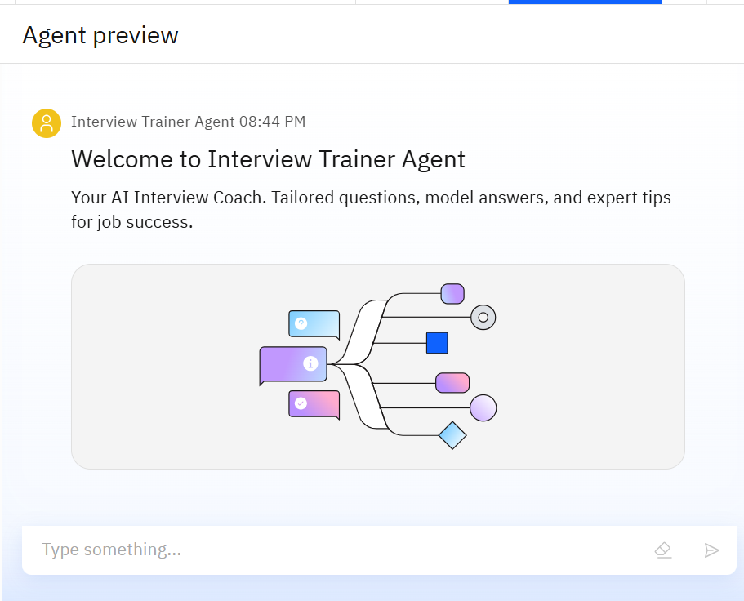
Results
This image shows the agent's welcoming interface, ready to initiate a personalized interview preparation session. It highlights the clean, user-friendly design where the agent introduces itself and prepares to gather the user's profile information.

Slide 9
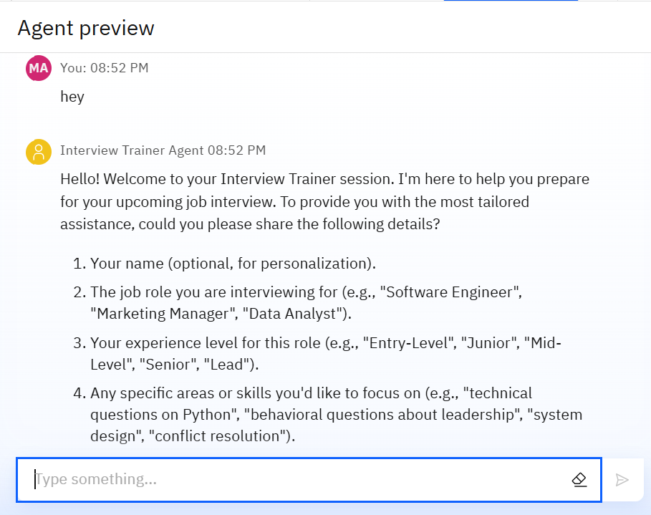
Results
Here, the agent engages the user in a collaborative information-gathering phase. It politely prompts for critical details such as job role and experience level, which are essential for tailoring the upcoming interview questions and advice.

Slide 10
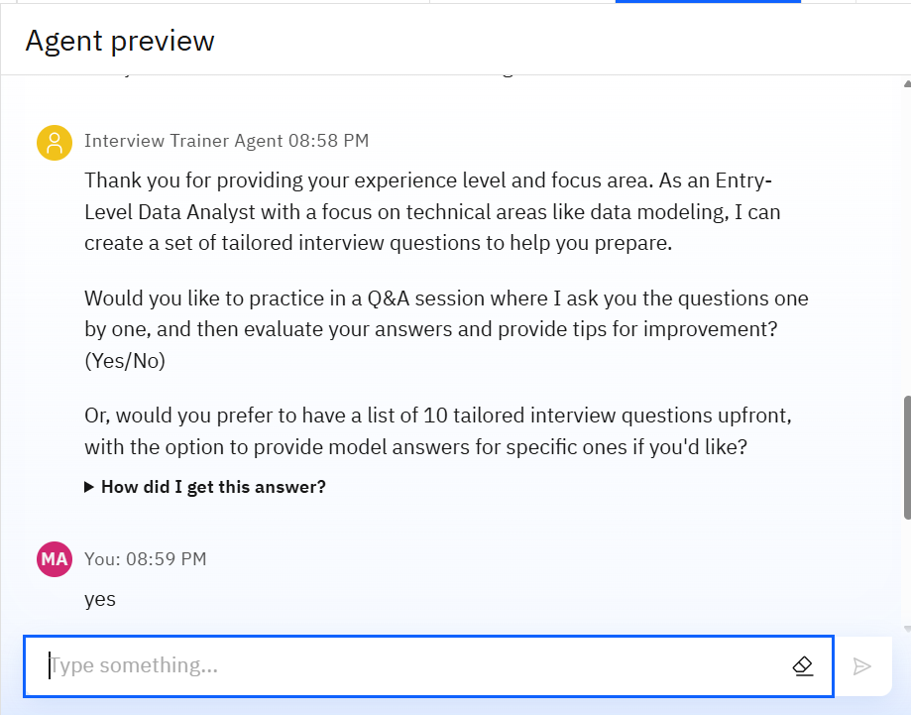
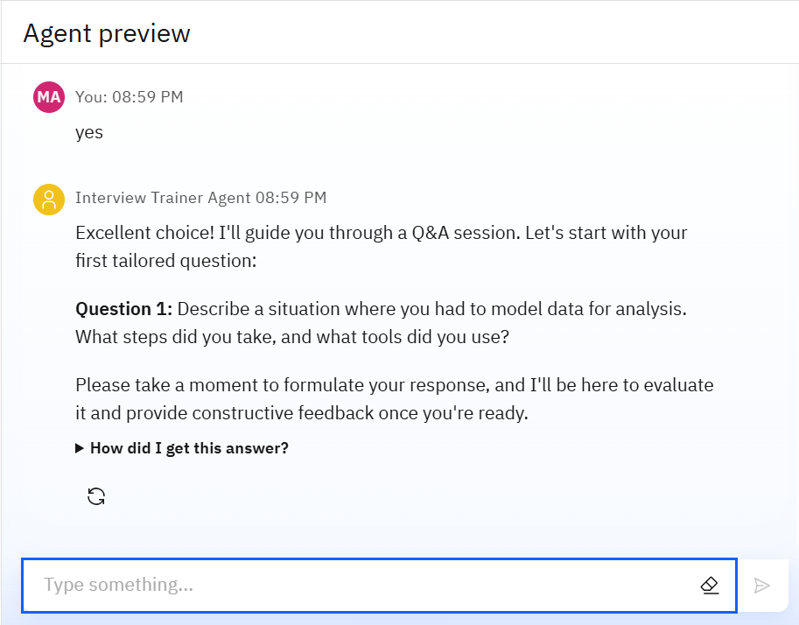
Results

Slide 11
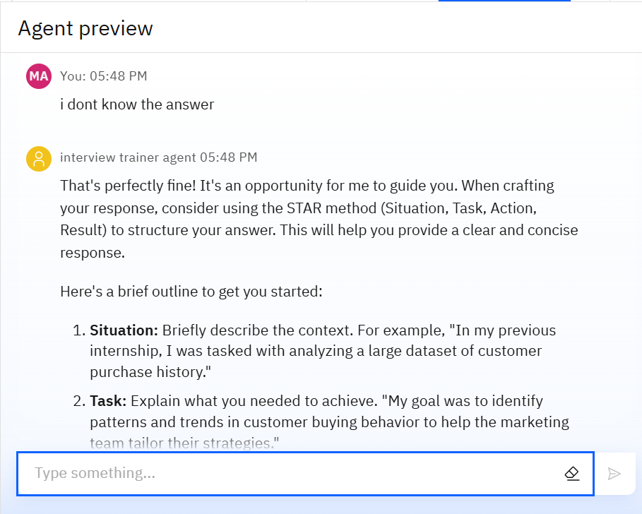
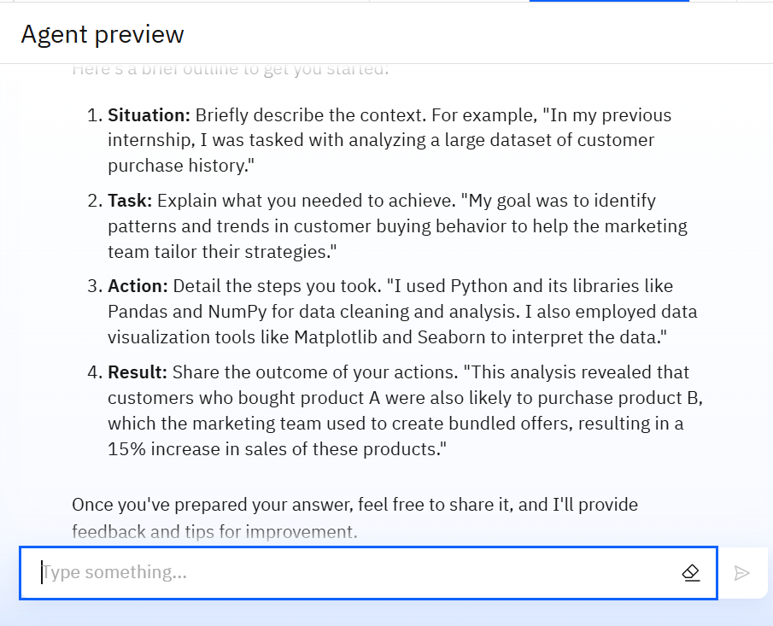
Results
Deployed AI Agent

Slide 12
Conclusion
The AI Interview Trainer Agent effectively addresses the challenge of generic interview preparation by offering a personalized, interactive, and comprehensive coaching experience. Leveraging IBM Cloud Lite services and the Granite model, it demonstrates how RAG can be applied to provide highly contextual and valuable assistance.It saves time by automating repetitive tasks like citation management and data extraction.
By generating tailored questions, providing insightful model answers, and delivering actionable feedback, the agent significantly enhances a user's preparedness and confidence, ultimately increasing their chances of success in competitive job markets.

Slide 13
Future scope
Expanded Knowledge Base: Continuously integrate more specialized industry knowledge, latest interview trends, and company-specific information to enhance tailoring accuracy . Voice-Activated Research Assistant
Resume/Job Description Integration: Allow direct upload of a resume or job description for even more precise question generation and answer alignment. Research Gap and Novel Topic Identification
Voice-Activated Practice: Implement voice input and output for a more realistic mock interview experience, supporting verbal communication skills.AI-Assisted Paper Drafting
Multilingual Support: Expand language capabilities to assist a wider global audience.
Performance Tracking: Introduce features to track user progress, identify recurring weaknesses, and suggest targeted practice areas over time.
Integration with Career Platforms: Seamlessly connect with job boards and professional networking sites for direct application support.

Slide 14
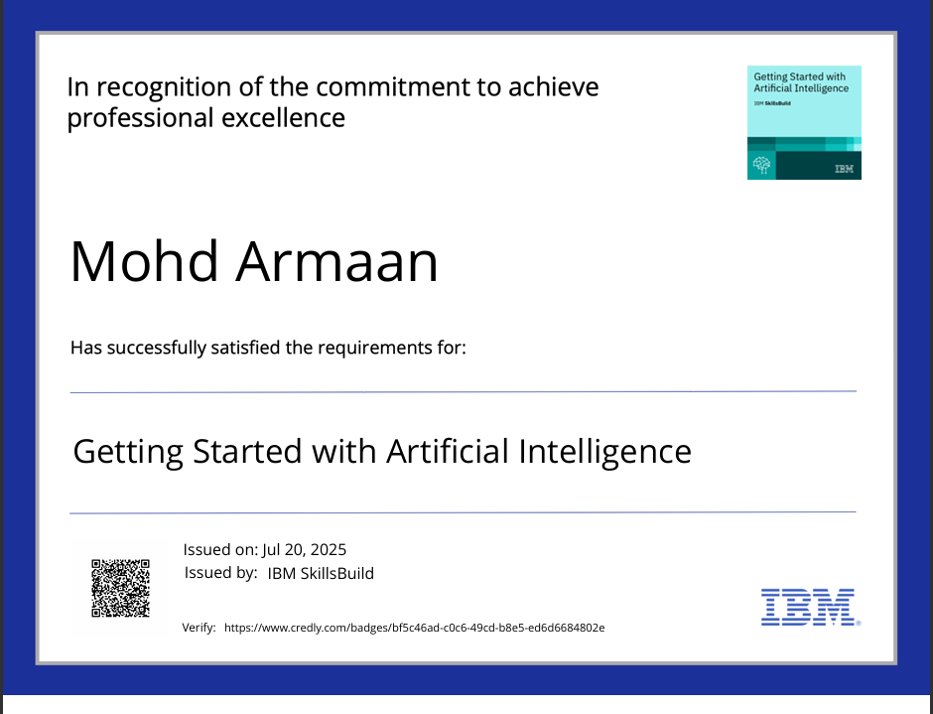
IBM Certifications
Screenshot/ credly certificate( getting started with AI)

Slide 15
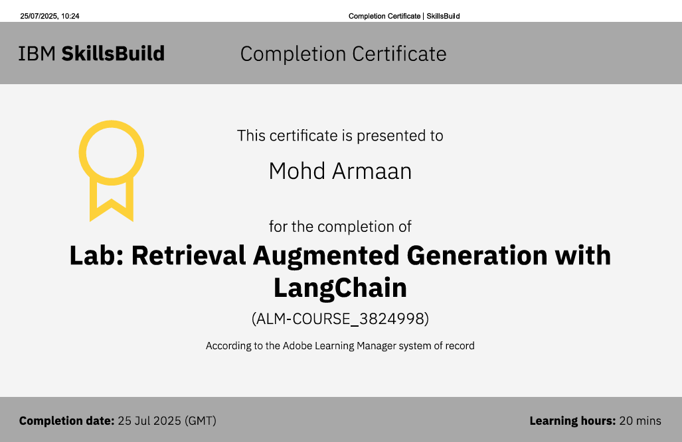
Attach your RAG LAB certificate here

Slide 16
GitHub Link
Git hub link : https://github.com/Armaanmd/Interview-Trainer-Agent-Watsonx.git

Slide 17
THANK YOU

